Slide 1
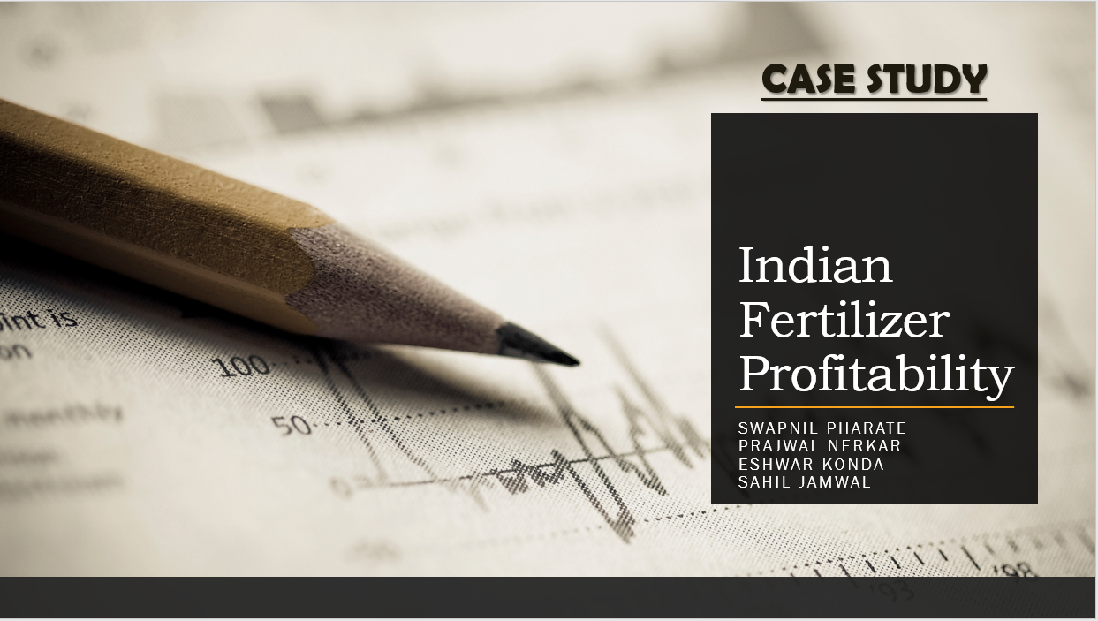
SEO Monthly Project Report
Here’s where your presentation begins

Slide 2
FERTILIZERS
Current Scenario of Indian Fertilizers:
India is the Second Largest Producer and Consumer of fertilizers in the World.
Total Production Of Fertilizers in India – 42 million metric tons
The Indian fertilizer market reached a value of INR 937 Billion in 2021. Looking forward, IMARC Group expects the market to reach INR 1,460 Billion by 2029, at a CAGR of 5.7% during a forecast period.
Imports of Fertilisers in India increased to 2909.68 USD Million in 2021 from 1412.38 USD Million in 2020. Imports of Fertilisers in India averaged 3367.56 USD Million from 1996 until 2021, reaching an all-time high of 12011.24 USD Million in 2008 and a record low of 358.72 USD Million in 2002
Notes:
CAGR - compound annual growth rate
IMARC- leading market research company this is group
--- international Master's in Advanced Research in Criminology (IMARC)

Slide 3
FERTILIZER IMPORT/EXPORT
2021 import
FY22 UREA import
2,909.68 USD Million
10.16 MT from China, Oman, UAE, Egypt, and Ukraine
Avg . Import from 1996 to 2021
3,367.56 USD Million
2021-22 MOP import
All time High in 2008
5.1 MT out of which 17.6 % from Belarus
12,011.24 USD Million
All time Low in 2002
2022 Export
358.72 USD Million
$400 Billion
Notes:
Imports of Fertilisers in India increased to 2909.68 USD Million in 2021 from 1412.38 USD Million in 2020. Imports of Fertilisers in India averaged 3367.56 USD Million from 1996 until 2021, reaching an all-time high of 12011.24 USD Million in 2008 and a record low of 358.72 USD Million in 2002
In FY22, India imported 10.16 MT of urea, mainly from China, Oman, UAE, Egypt and Ukraine.

Slide 4
FERTILIZERS
Current Scenario of Indian Fertilizers:
The Production of Urea in India has reached near Self-Sufficiency. The requirement for Nitrogenous Fertilizers is met through the Indigenous industry
“With this extraordinary milestone of $400 billion exports, India can move up from the current 20th position to 15th by surpassing the UAE, Switzerland, Spain, and other countries in 2022,”
FERTILIZERS | REQUIRED/YEAR MILLION TON (MT) | DOMESTIC PRODUCTION MILLION TON (MT) | IMPORT MILLION TON (MT)
UREA | 37.16 | 27 | 10.16
DAP | 12 | 5 | 7
MOP | 5.1 | 0 | 5.1
COMPLEX FERTILIZERS | 13 | 9.5 | 3.5
Notes:
MOP - Muriate of Potash
Russian ally Belarus is one of the leading suppliers of MOP to the Indian markets. In the 2021-22 financial year, out of the 5.1 million tonnes of MOP imported into India, around 17.6 percent came from Belarus. MOP is 100 per cent imported into India.

Slide 5
MAIN FERTILIZERS PRODUCED IN INDIA
01
02
03
04
UREA
DAP
SSP
COMPLEXES
Also known as Carbamide
DI-AMMONIUM PHOSPHATE
SINGLE SUPER PHOSPHATE
NPK variants, multi-chemical combined fertilizers
Notes:
Add pie chart

Slide 6
INDUSTRY ANALYSIS
The Indian fertilizer industry comprises various government and private fertilizer companies which produce a variety of fertilizers. Indian Farmers Fertiliser Cooperative Limited (IFFCO), is the largest fertilizer manufacturer and marketer
65 Large sized Fertilizer Plants in India
32 units of Urea
20 Units of DAP & Complex Fertilizers
13 units of Ammonium Phosphate
Nitrogenous Fertilizers – 88 % Urea, 10 % DAP % 2% Ammonium Fertilizers.
Notes:
At present 22 grades of P&K fertilizers namely DAP, MAP, TSP, MOP, Ammonium Sulphate, SSP and 16 grades of NPKS complex fertilizers are covered under the NBS Policy

Slide 7
FERTILIZERS NUTRIENTS (NBS RATE rs/kg)
Nutrients Year | "N" Nitrogen | "P" Phosphate | "K" Potash | "S" Sulphur
2011-2012 | 27.153 | 32.338 | 28.756 | 1.677
2012-2013 | 24 | 21.804 | 24 | 1.677
2013-2014 | 20.875 | 18.679 | 18.833 | 1.677
2014-2015 | 20.875 | 18.679 | 15.5 | 1.677
2015-2016 | 20.875 | 18.679 | 15.5 | 1.677
2016-2017 | 15.854 | 13.241 | 15.47 | 2.044
2017-2018 | 18.989 | 14.997 | 12.395 | 2.24
2018-2019 | 18.901 | 15.216 | 11.124 | 2.722
2019-2020 | 18.901 | 15.216 | 11.124 | 3.562
2020-2021 | 18.789 | 14.888 | 10.116 | 2.374
2021-2022 | 18.789 | 45.323 | 10.116 | 2.374

Slide 8
Fertilizer Consumption
Urea and DAP are the most Popular fertilizers accounting for 53% and 18 % respectively, of the total fertilizer material consumed in the country.
The agreed ratio of NPK elements for balanced soil health and crop growth is 4:2:1 but the average ratio of NPK use In India is 8.2 : 3.2 : 1
This also is heavily skewed in different 33.7 : 8 : 1 in Punjab which is highest and 1.3 :0.7 : 1 in Kerala which is lowest in 2020-21.

Slide 9
Paradigm shift in Fertilizer sector in india
Fertilizer Consumption an food grain production is closely correlated.
Food grain Production increasing steadily
Current Crop Production needs to be increased by up to 70% to satisfy future food demand.
In India at present, in about 145 lakh hectares area, Kharif crops and in about 119 lakh hectares area, rabi crops are being taken up.
The total grain demand will increase from 201 million tonnes in 2000 to about 291 and 377 million tonnes by 2025 and 2050, respectively.
So the higher demand in the fertilizer sector in the upcoming years.

Slide 10
Strategies towards Independent and Export Fertilizers from India
Self-reliance in fertilizer production Five urea plants at Gorakhpur, Sindri, Barauni, Talchar, and Ramagundam are being revived. | Rationalization of Subsidy Policy First step Towards this could be bringing Urea under NBS
Alternative nutrition for plants Non-chemical fertilizers, Compost, organic/Bio-fertilizers etc. | Enhance Fertilizer Efficiency
Notes:
Nutrient Based Subsidy Scheme (NBS)
6.0 crore bottles of nano urea will be produced and made available to farmers. These 6.0 crore bottles will be equivalent to 27 lakh MT quantity of conventional urea

Slide 11
DASHBOARD

Slide 12
Thank You

